Slide 1
Robotics phase 3 demo
Jawahar Pinnelli - jp2141
Pradeep Roy Yadlapalli - py160

Slide 2
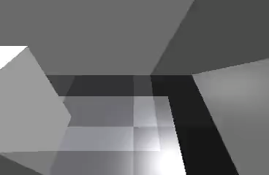
Run 1

Slide 3
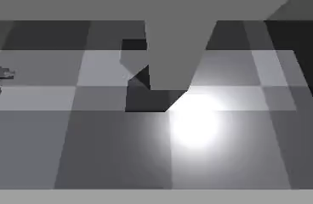
Run 2

Slide 4
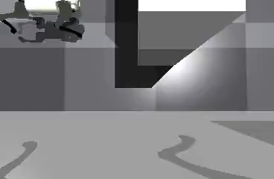
Run 3

Slide 5
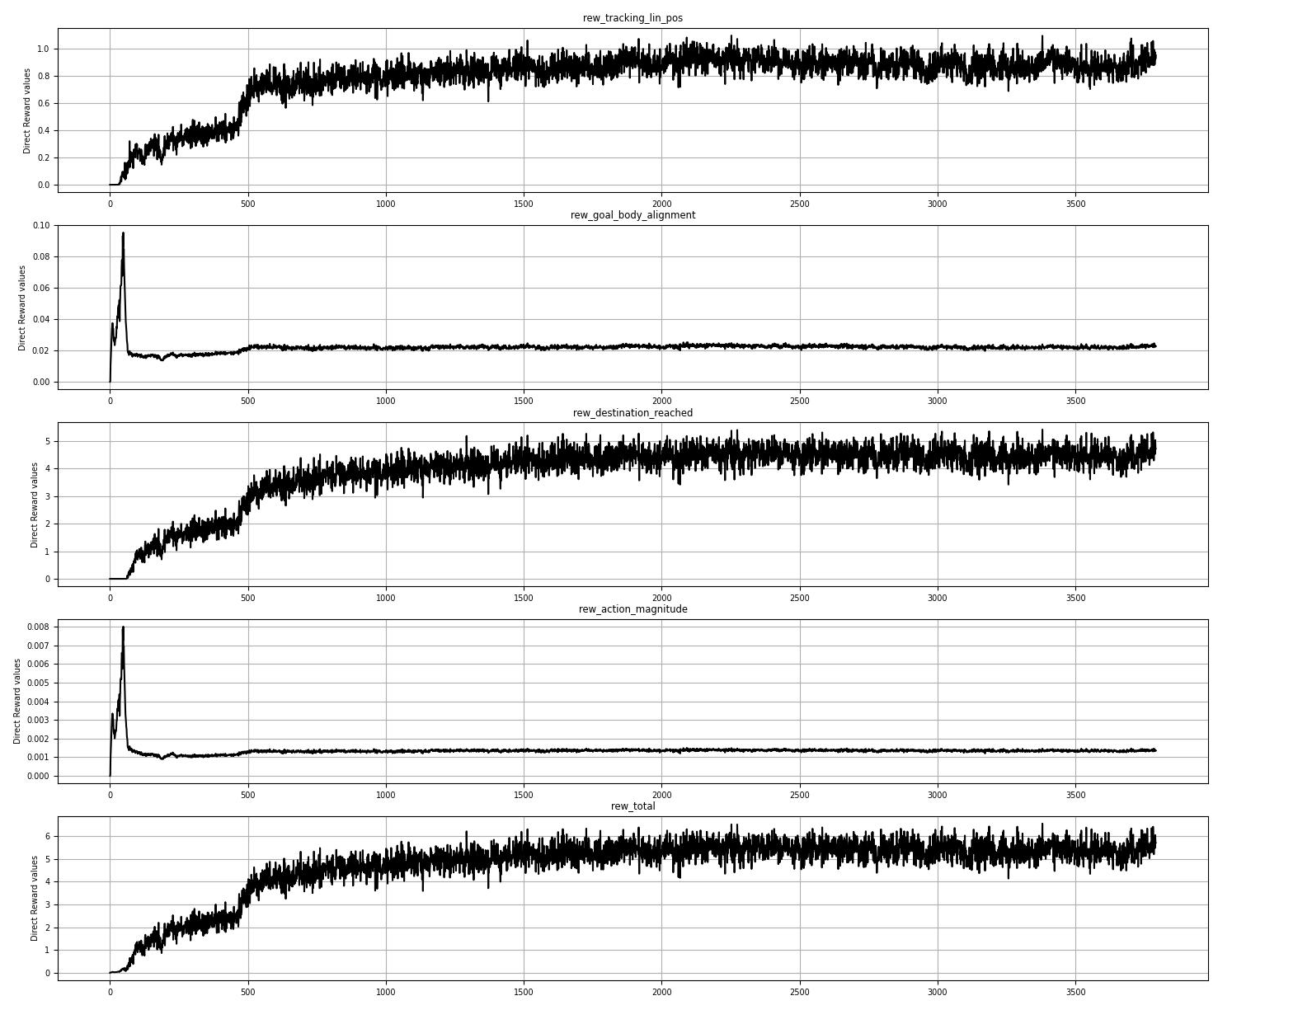
Phase 3 – Plots
Reward scales:
tracking_lin_position = 2
goal_body_alignment = 0.01
action_magnitude = 0.001
destination_reached = 400

Slide 6
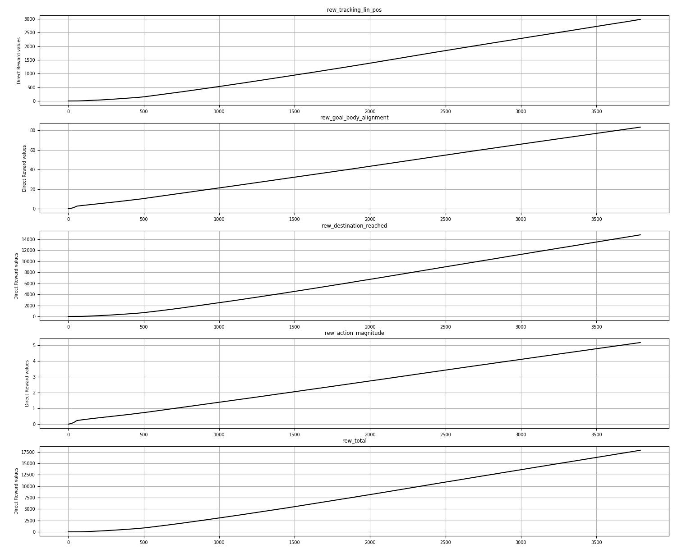
Phase 3 – Plots

Slide 7
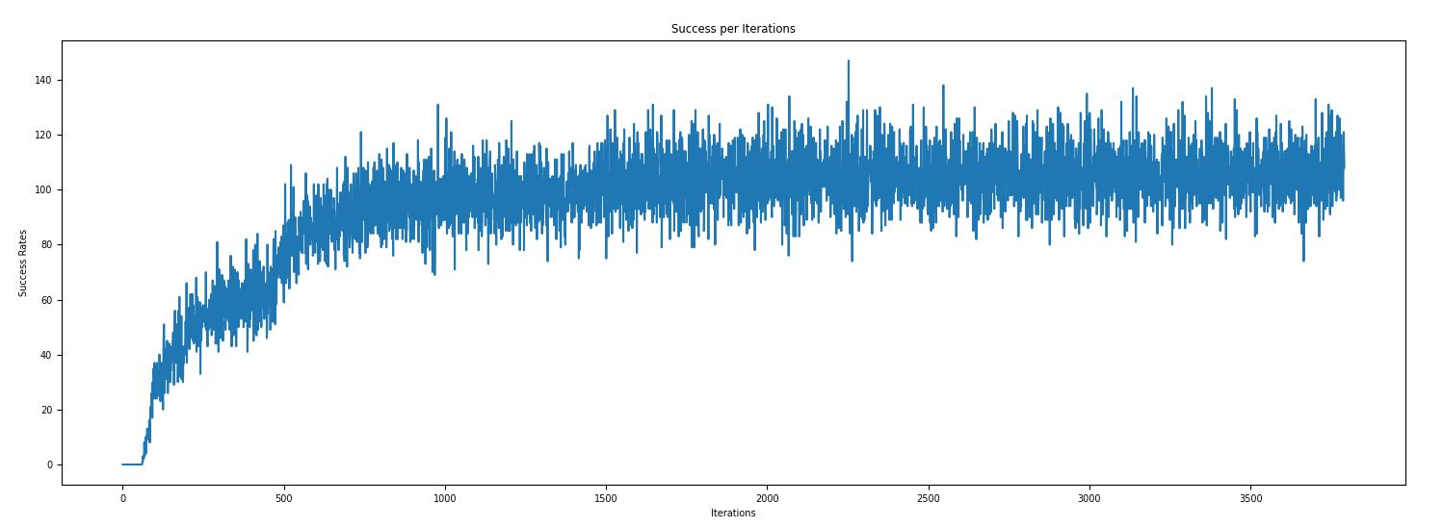
Phase 3 – Plots

Slide 8
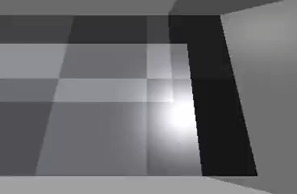
Phase 2 – Random start - 1

Slide 9
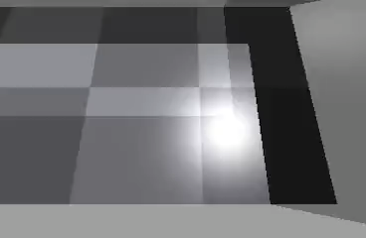
Phase 2 – Random start - 2

Slide 10
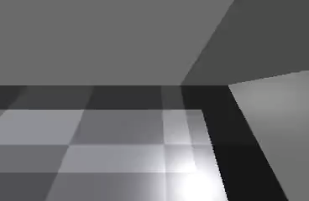
Phase 2 – Random start - 3

Slide 11
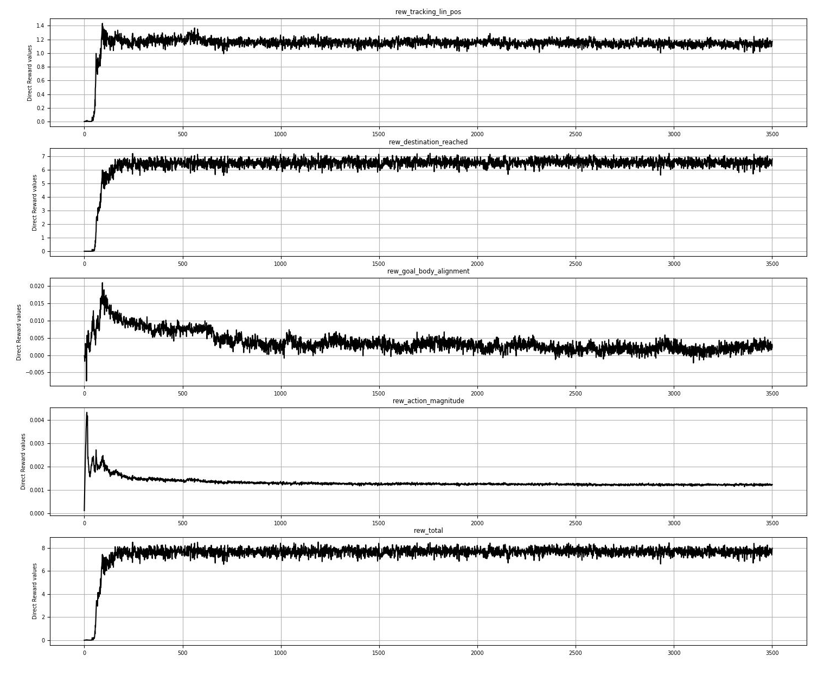
Phase 2 – Plots
Reward scales:
tracking_lin_position = 2
goal_body_alignment = 0.01
action_magnitude = 0.001
destination_reached = 400

Slide 12
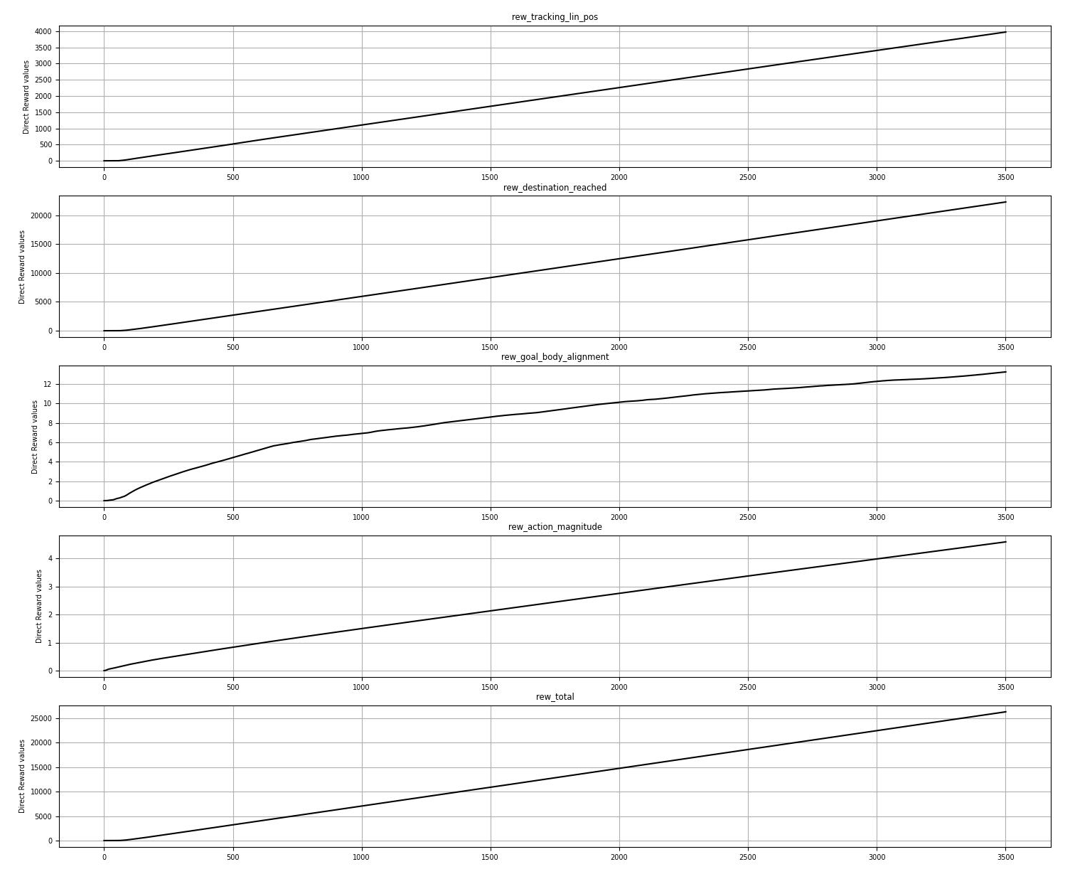
Phase 2 – Plots

Slide 13
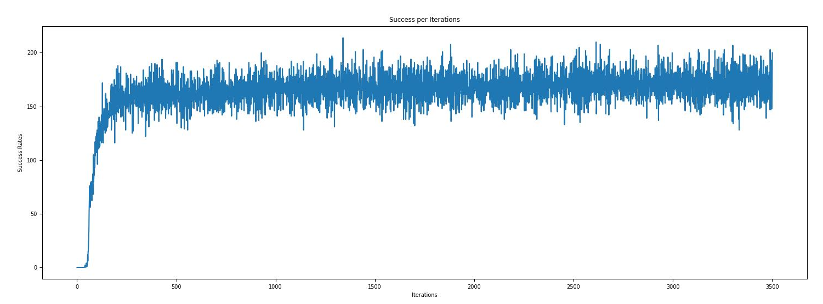
Phase 2 – Plots

